Slide 1


What to Expect When You Are Expecting ASP.NET Core 3.0
Isaac Levin
Application Development Manager – Microsoft
@isaac2004

Slide 2














Your platform for building anything
DESKTOP
WEB
CLOUD
MOBILE
GAMING
IoT
AI
.NET
Notes:
There has never been a better time to be a .NET Developer! With .NET you can build applications for virtually every platform, from a Windows desktop application to a website to an IoT device.

Slide 3
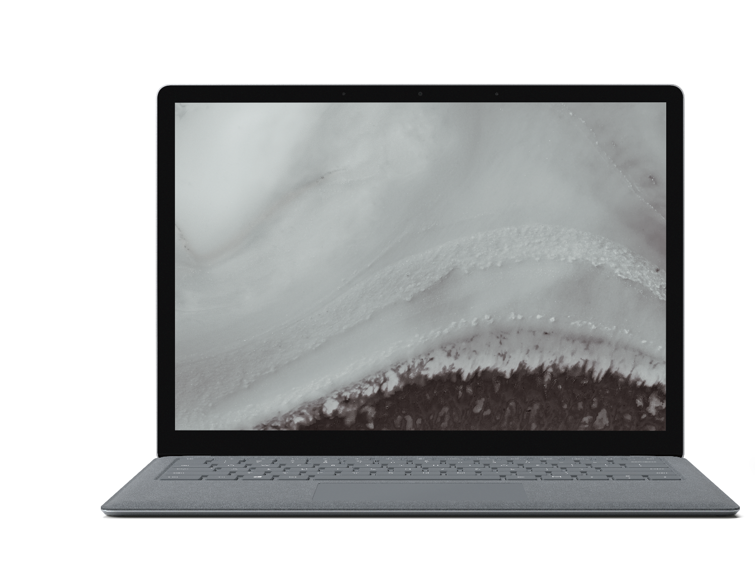
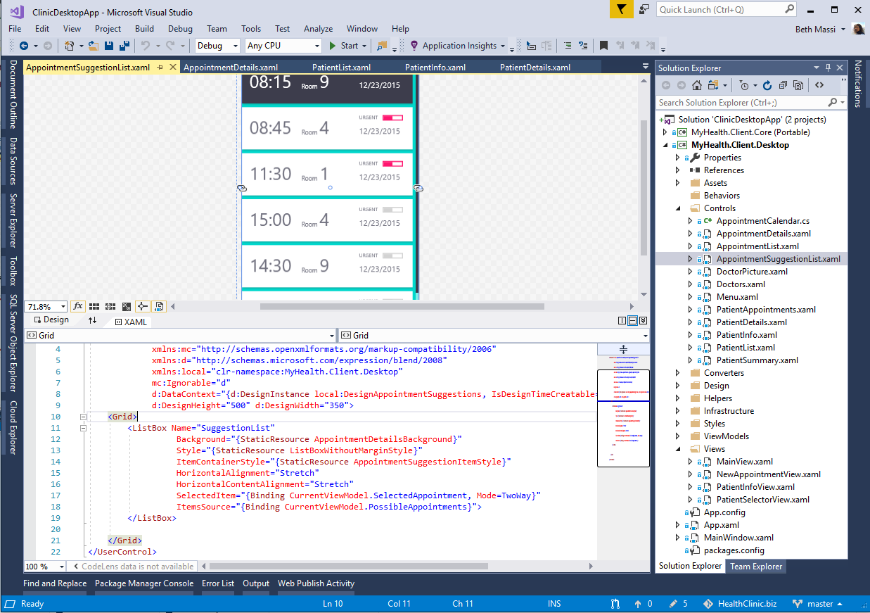
ANNOUNCING
.NET Core 3.0 Preview 8
Windows desktop support with WPF and WinForms, also open source
Flexible deployment, side-by-side support and self-contained EXEs
Full-stack web development with C# and Razor
Significant performance improvements
New C# language features for productivity and less errors
Notes:
At BUILD we have announced Preview 5 of .NET Core 3.0 It comes with significant updates to desktop and server workloads.
.NET Core 3 brings Windows desktop development to .NET Core, with support for WinForms and WPF.
It enables more flexible deployment with side-by-side and self-contained EXEs.
We also have new features on the server side, including composable UIs with ASP.NET Core with Razor Components, which will provide full-stack web development with .NET for the first time.

Slide 4
Major Changes to .NET
.NET Core Coming to Windows Desktop
WPF and Windows Forms
High DPI
MSIX Support
C# 8 Is Coming
Async Streams
Nullable Reference Types
Pattern Matching
Indices and Ranges
New APIs added via .NET Standard 2.1
Span<T>
DbProviderFactories
Nearly 3k new APIs
Single-File Executables
System.Text.Json
Json Serializer Built on Span<T>

Slide 5
What Cheese is Moving in ASP.NET?
ASP.NET Core Will Only Run on .NET Core
No longer able to target proper .NET Framework
Many Assemblies being removed from AspNetCore.App 3.0
Auth, EF, Json.NET, Roslyn and more
When upgrading from 2.1, manually adding packages will be required
SpaServices and NodeServices Obsoleting
All SPAs have some form of CLI
No longer needed after 2.1
Replace with SpaServices.Extensions + platform CLI
Will be removed in .NET 5
Notes:
With .NET Core 3.0 now it’s easier than ever to build a full stack solution.
When it comes to build the frontend. .NET Core 3.0 retains and improves all the great features which you already know from previous .NET Core versions:
MVC and Razor Pages for building the UI
Web APIs for building services
SignalR to create real-time applications
Full support for authentication and security
When it comes to build the client, however, .NET Core 3.0 comes with something new: Blazor, which through WebAssembly supports building client applications using C# and .NET instead of JavaScript. Of course, .NET Core 3.0 still offers great support for building client apps with traditional JavaScript based development and it fully supports the most recent versions of popular frameworks like Angular or React.
Also when it comes to build the backend, .NET Core 3.0 offers some new powerful features:
Worker service, which is a new template to build cross-platform services that can run continuously in background
gRPC, which is a standard communication protocol to facilitate the communication between different components

Slide 6



.NET Core 3.0: A full stack solution
Client
Frontend
Backend
http://..
gRPC
gRPC
Worker
ASP.NET Core
Blazor
Components
SPA (JavaScript)
MVC / Razor Pages
Web APIs
SignalR
Security & identity
Worker services
gRPC
Notes:
With .NET Core 3.0 now it’s easier than ever to build a full stack solution.
When it comes to build the frontend. .NET Core 3.0 retains and improves all the great features which you already know from previous .NET Core versions:
MVC and Razor Pages for building the UI
Web APIs for building services
SignalR to create real-time applications
Full support for authentication and security
When it comes to build the client, however, .NET Core 3.0 comes with something new: Blazor, which through WebAssembly supports building client applications using C# and .NET instead of JavaScript. Of course, .NET Core 3.0 still offers great support for building client apps with traditional JavaScript based development and it fully supports the most recent versions of popular frameworks like Angular or React.
Also when it comes to build the backend, .NET Core 3.0 offers some new powerful features:
Worker service, which is a new template to build cross-platform services that can run continuously in background
gRPC, which is a standard communication protocol to facilitate the communication between different components

Slide 7
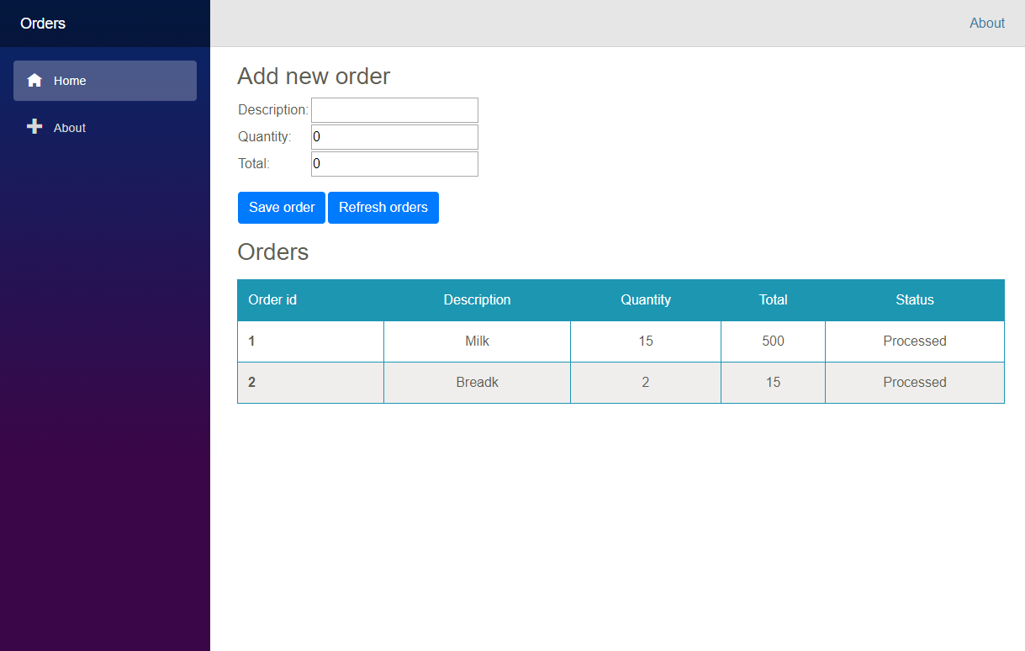
Let’s build an order management app!
Notes:
Let’s use all these new features added in .NET Core 3.0 to build an order management application!

Slide 8

A full stack application
?
gRPC
http://..
?
?
Worker
ASP.NET Core
Orders
Workers
Notes:
This is the architecture of our application:
The client side is the UI of the application, which allows the user to add an order to the system.
The ASP.NET Core application acts as a server-side backend to perform operations which can’t be executed client-side (like database access)
Orders needs time to be processed, so the operation doesn’t happen in real-time. Instead, we have a background worker that processes them and then it takes care of updating the status on the database once finished.
We need a service to handle the communication between the application and the background worker. The service must query whenever there’s a new pending order to process and dispatch it to the worker.
We’re going to use new ASP.NET Core 3.0 components to build our application:
The client will be implemented using Blazor
The background worker will be implemented using the new worker service template
The service will be implemented using gRPC

Slide 9
The frontend
gRPC
http://..
Worker
ASP.NET Core
Orders
Workers
Notes:
Let’s start with the frontend.

Slide 10

Blazor
Build client-side web UI with .NET instead of JavaScript
Call into JavaScript libraries & browser APIs as needed
Write reusable web UI components with C# and Razor
Share .NET code with both the client and the server
Blazor for WebAssembly now in official preview!
Notes:
Blazor is a framework to build web applications using C# and .NET instead of JavaScript to write client-side logic.
It supports building components, which can be reused by multiple projects.
Since they both run C# and .NET, you can easily share code (services, entities, etc.) between the client ant the server.
Blazor supports JavaScript interop, which allows you to call JavaScript code (like libraries or browser APIs) from C#
Blazor has born as an experimental project, but one week before BUILD we have announced that it’s now in official preview, meaning that in the future will ship as part of the .NET family.

Slide 11


Blazor on client or server
Client-side
Server-side
https://...
https...
ASP.NET Core
Razor Components
DOM
SignalR
DOM
.NET
WebAssembly
Razor Components
.NET
Future
.NET Core 3.0
Notes:
There are two flavors of Blazor:
Blazor client-side runs completely on the browser thanks to WebAssembly.
Blazor server-side uses the same development model, but the C# code and the Razor pages are rendered server-side and then dispatched to the client using SignalR.
Blazor client-side:
Pros: it can run offline. The execution is faster, because everything is rendered by the browser itself.
Cons: longer startup timings, due to the requirement to load the whole .NET Framework and assemblies inside the browser.
Blazor server-side:
Pros: the startup timing is faster. It supports full debugging. It supports every .NET API and library which runs with ASP.NET Core. It works also with old browsers that don’t support WebAssembly, like Internet Explorer.
Cons: it doesn’t run offline. The execution is slower, since it requires a constant connection with the server.
Blazor client-side is the future. It’s in official preview, but it won’t ship with .NET Core 3.0, but with a later version.
Blazor server-side is the present (near future), since it will be part of .NET Core 3.0.

Slide 12
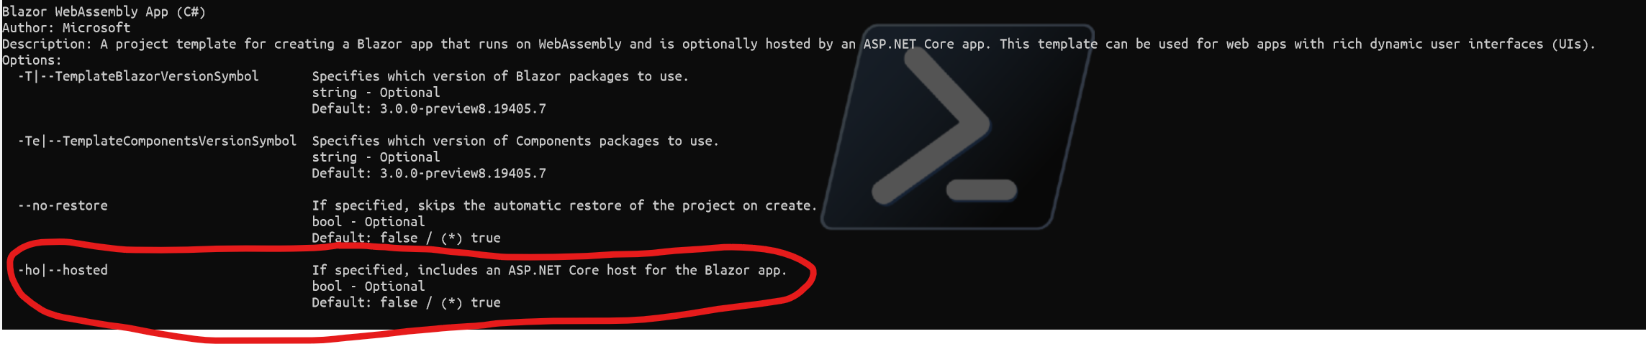
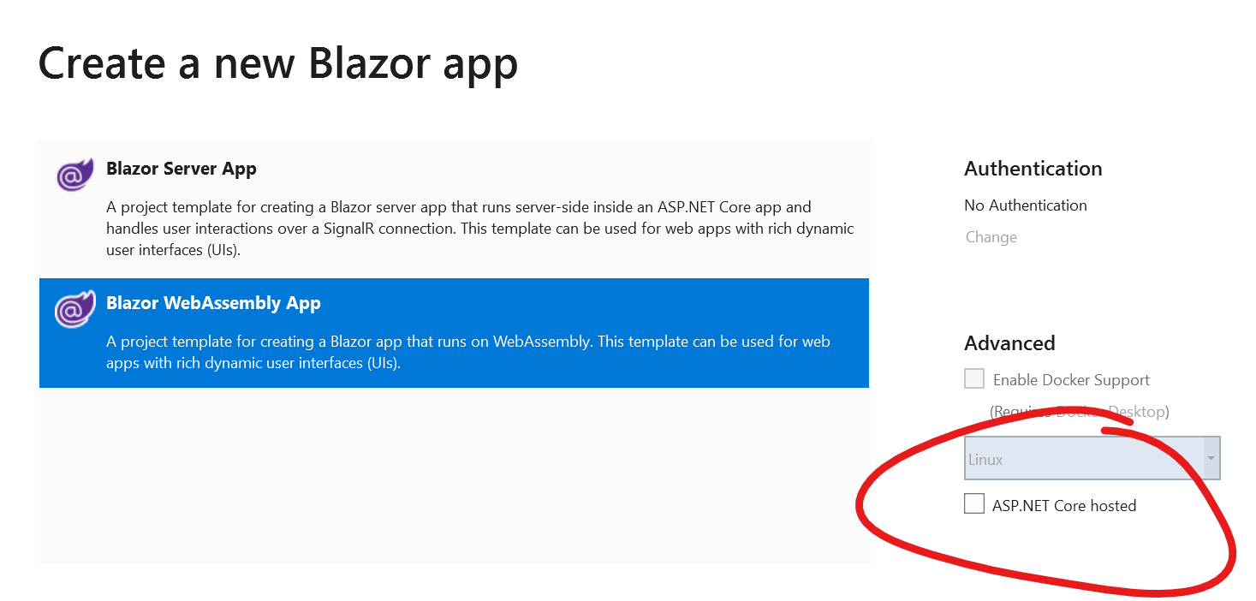
Client Blazor with Hosted Backend
Notes:
There are two flavors of Blazor:
Blazor client-side runs completely on the browser thanks to WebAssembly.
Blazor server-side uses the same development model, but the C# code and the Razor pages are rendered server-side and then dispatched to the client using SignalR.
Blazor client-side:
Pros: it can run offline. The execution is faster, because everything is rendered by the browser itself.
Cons: longer startup timings, due to the requirement to load the whole .NET Framework and assemblies inside the browser.
Blazor server-side:
Pros: the startup timing is faster. It supports full debugging. It supports every .NET API and library which runs with ASP.NET Core. It works also with old browsers that don’t support WebAssembly, like Internet Explorer.
Cons: it doesn’t run offline. The execution is slower, since it requires a constant connection with the server.
Blazor client-side is the future. It’s in official preview, but it won’t ship with .NET Core 3.0, but with a later version.
Blazor server-side is the present (near future), since it will be part of .NET Core 3.0.

Slide 13
Demo
Build client web UI with Blazor

Slide 14
The worker
gRPC
http://..
Worker
ASP.NET Core
Orders
Workers
Notes:
Let’s see now how we can implement the background worker component of our solution.

Slide 15
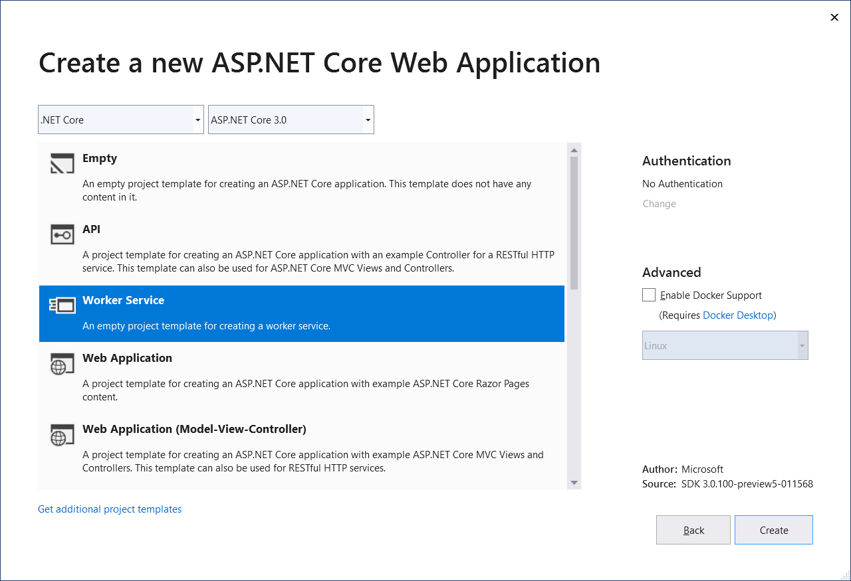
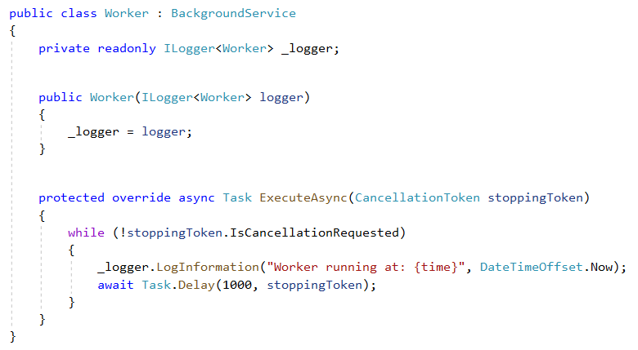
Worker services
New Worker service template
Build long-running worker processes
May or may not have endpoints
Host in Windows services, systemd, WebJobs, containers
Integrates with configuration, logging, dependency injection
Notes:
Worker services is a new template included in .NET Core 3.0, which you can use to build long-running processes. It supports a cross-platform model, so it can be hosted as a Windows Service, as a Linux job, as a Web Job on Azure, inside a container, etc.
It brings all the benefits of ASP.NET Core development (configuration, logging, dependency injection, etc.) to the worker services world.

Slide 16
Demo
Worker services

Slide 17
Handling the communication
gRPC
http://..
Worker
ASP.NET Core
Orders
Workers
Notes:
And now let’s see the last part of our architecture, which is the communication between the main application and the worker service.

Slide 18
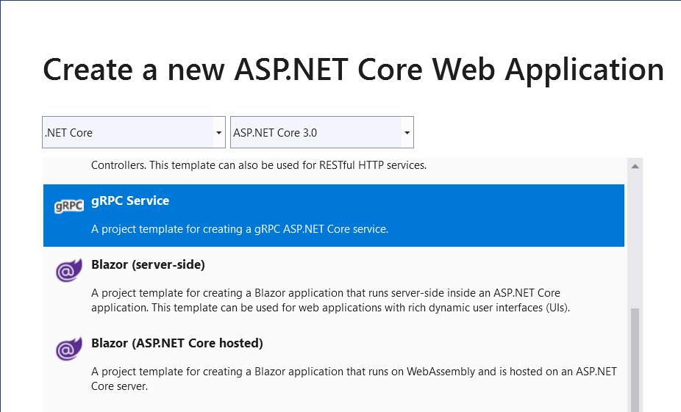
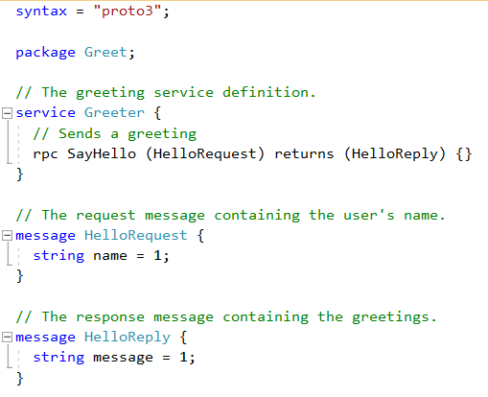
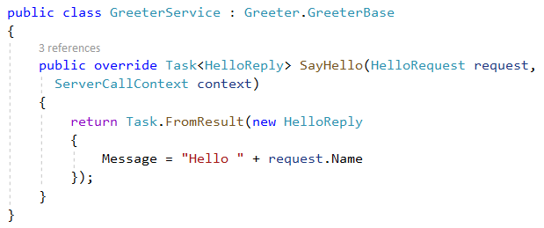
gRPC
High performance, contract-based RPC services
Broad interoperability for polyglot environments
Great for service-to-service communication
Notes:
gRPC is service which offers high performances and it’s based on a standard contract, which offers broad interoperability across multiple languages and frameworks. It’s widely used for service-to-service communication, even if they are developed with different languages or they run on different platforms.

Slide 19
Demo
The full architecture

Slide 20
Also new in ASP.NET Core 3.0
Simplified shared framework
Blazor (server-side)
gRPC
Worker
IdentityServer
API code generation
Endpoint routing integration
C# 8 in Razor & MVC
JSON
Windows service support
SignalR auto-reconnect, streaming
SignalR C++ client
Certificate & Kerberos authentication
Performance
Event counters*
*Coming soon!
Notes:
In this session we have seen the top 3 features added in .NET Core 3.0, but there’s much more as you can see from this list. You’re invited to read the documentation on the ASP.NET website to learn more about all the other new features.

Slide 21
Schedule
Preview 8 - Live
Preview 9 - September
GA - September???
.NET Core 3.0 Launches at .NET Conf
September 23 – 25, 2019
Notes:
.NET Core 3.0 right now is in Preview 5 (or 6, depending when you’re delivering the session) and the GA will happen in September. Approximately every month until GA there will be a new preview. Preview 7 and 8 will have a go-live license, which means that they can be used for production workloads.

Slide 22
QUESTIONS???

